Slide 1

smart Video Solutions for fashion store optimization
Project By : vishnu vardhan. K

Slide 2
Table of contents :
Abstract
Introduction
System Requirements
System Architecture
Analytical Insights with Tableau
Conclusion

Slide 3
Abstract
Developments in IoT applications are becoming an important role in our day-to-day life, starting from business predictions to self driving cars. This project intends in designing a cost-effective people counting system with AI at Edge, where it calculates Conversion rates using total number of people counted by the system and number of transactions for the day, which helps in providing analytical insights for fashion optimization with a very minimum hardware requirements.

Slide 4
introduction
People counters are essentially any type of device that counts the number of people walking in and out of a certain specified area.
While people counters started out as a simple, manual clicker in the hands of a doorman, they have quickly evolved to sensor technologies i.e.,[Pressure sensitive mats, Infrared beam counters and thermal counters].
Most of the major offline retailers are now investing in advanced people counters to level the online-offline playing field and access the same level of in-depth data as ecommerce brands to understand and optimize store conversion and sales.
According to Caprillary technologies, starting from 2018 to coming future, The people counting systems will get upgraded to Computer Vision & AI-Powered People Counters which will be the most cost effective and requires very minimum hardware.
Highly accurate Computer vision models process in cloud to perform inference. As the model inferencing is needed when a network is not available, This is where “AI at Edge” comes to play. Edge applications are used for real-time decision making and avoid sending data to cloud to perform inference.

Slide 5
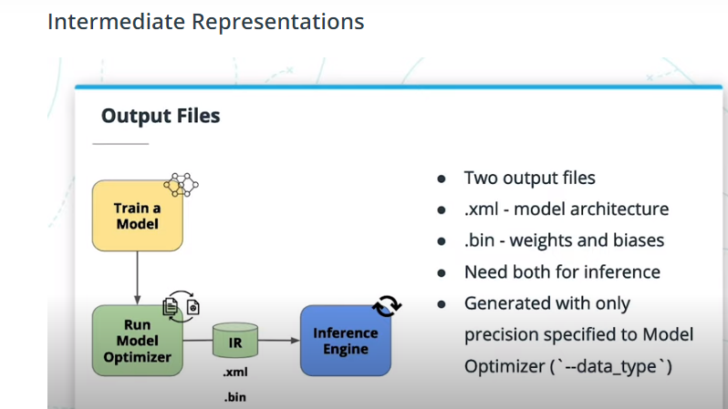
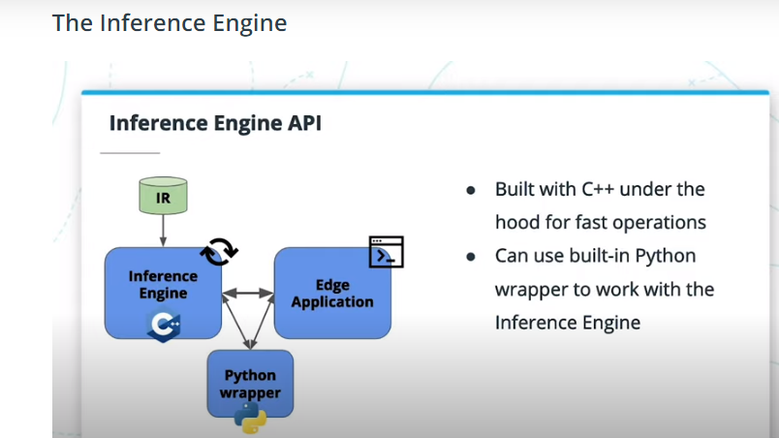
Intel’s Distribution for OpenVINO Toolkit:
OpenVINO[Open Visual Inferencing and Neural Network Optimization] An open source library useful for edge deployment due to its performance maximizations and pre-trained models.
This toolkit helps in optimizing neural network inferencing across a variety of Intel hardware and helps optimizing speed and decrease in model size for inference at Edge.
We can train a model in any Framework in cloud and give it Model Optimizer in OpenVINO toolkit which has the ability to converts the models from multiple Frameworks to Intermediate Representation[IR] for Inference Engine which is the main component to perform inference at Edge.

Slide 6
System requirements
Hardware Requirements: PC or Desktop[with any intel processors], Camera, 4GB RAM[minimum]
Software Requirements: Python IDE[3.x version], Intel’s OpenVINO toolkit, Tableau

Slide 7



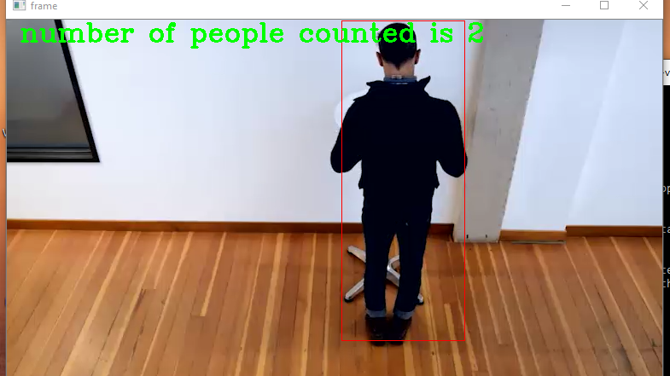
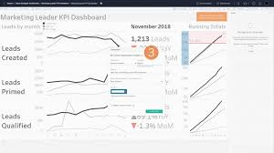
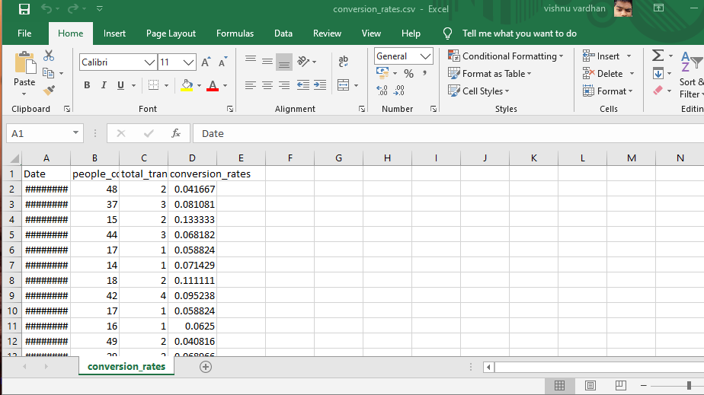
System architecture
Passing input feed
Camera taking the input feed of a person walking into store
Counting no.of people walked into store using person detection model
passing data
Optimize operations to improve store’s perfomance
Export data to tableau
database
Analytical insights with tableau

Slide 8
In this people counting system, we need to either create a human detection model in any AI framework and then convert the model to IR [Intermediate Representation] format with Intel’s distribution of OpenVINO Toolkit or use a pre-trained model which is provided by OpenVINO.
The camera takes the input feed from store’s entrance and send the input feed to the human detection model to perform inference at Edge to count the people. As the number of people coming in = number of people going out so, At the end of the day total number of people counted = number of people counted / 2.
We have to enter number of transactions happened in a day to calculate conversion rate. Conversion rate = (total number of transactions / customer traffic) * 100. The data [date, people counted, transactions, conversion rate] will be send to the database everyday automatically.
The Data from the database will get exported to Tableau [ A Data Visualization tool ] for analytical insights and build dashboards to get an overview of how well your store is performing.
According to Fashion E-Commerce, Conversion rates will determine the success rate of a store. An online Fashion website has an average of 3 percent of conversion rates whereas, an offline fashion store has an average of 22.5 percent of conversion rates.
With these insights on conversion rates, we can improve the store’s operations to perform better using the past generated data for a better future.

Slide 9
Analytical insights with tableau
As the data will get generated and stored, lets analyze a custom dataset with similar features as of the generated data for insights.
The dataset “conversion_rates.csv” which we are using to produce insights using Tableau is present in : https://github.com/KVishnuVardhanR/smart-Video-Solutions-for-fashion-optimization/tree/master/resources repository.
With Tableau we will be creating a wonderful story using dashboards and worksheets to convey the insights which we observed during the analysis.
So, as we have a custom dataset, lets start building a story in Tableau and analyze it. The coming slides are the story created by Tableau using the “conversion_rates.csv” dataset for analytical insights.

Slide 10
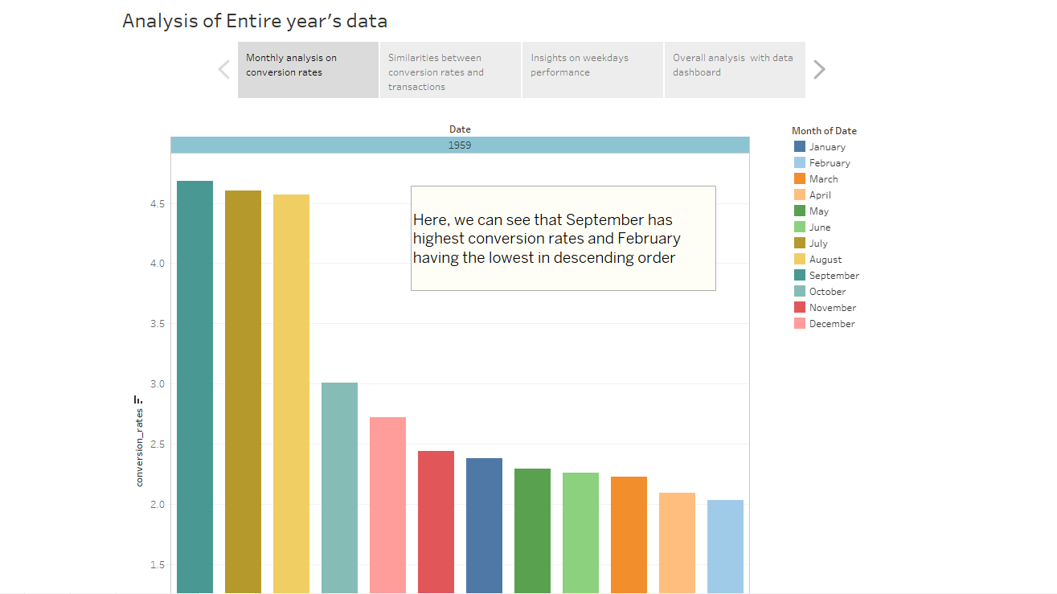

Slide 11
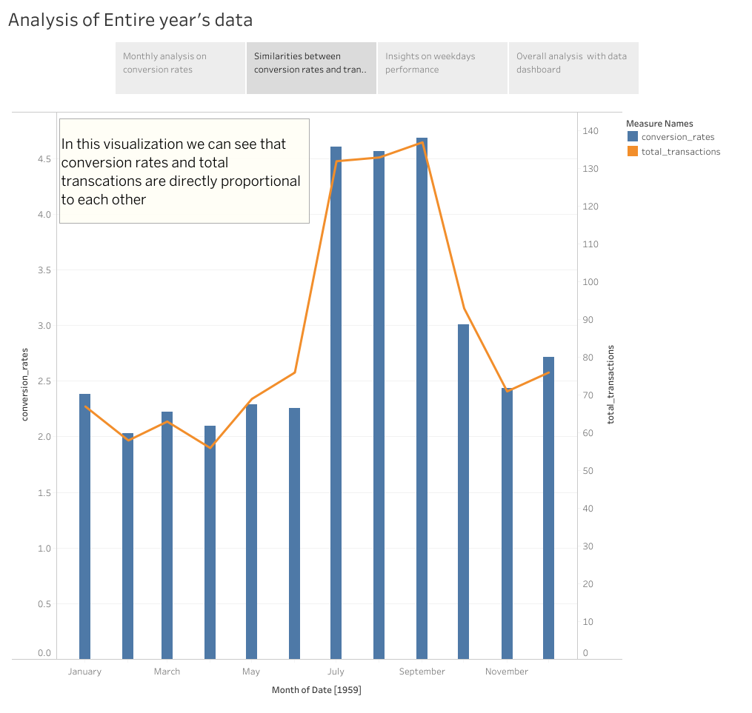

Slide 12
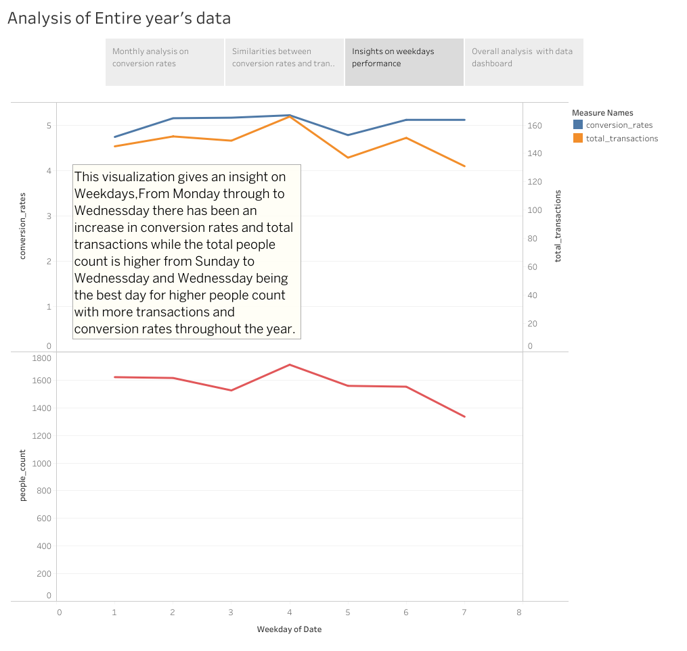

Slide 13
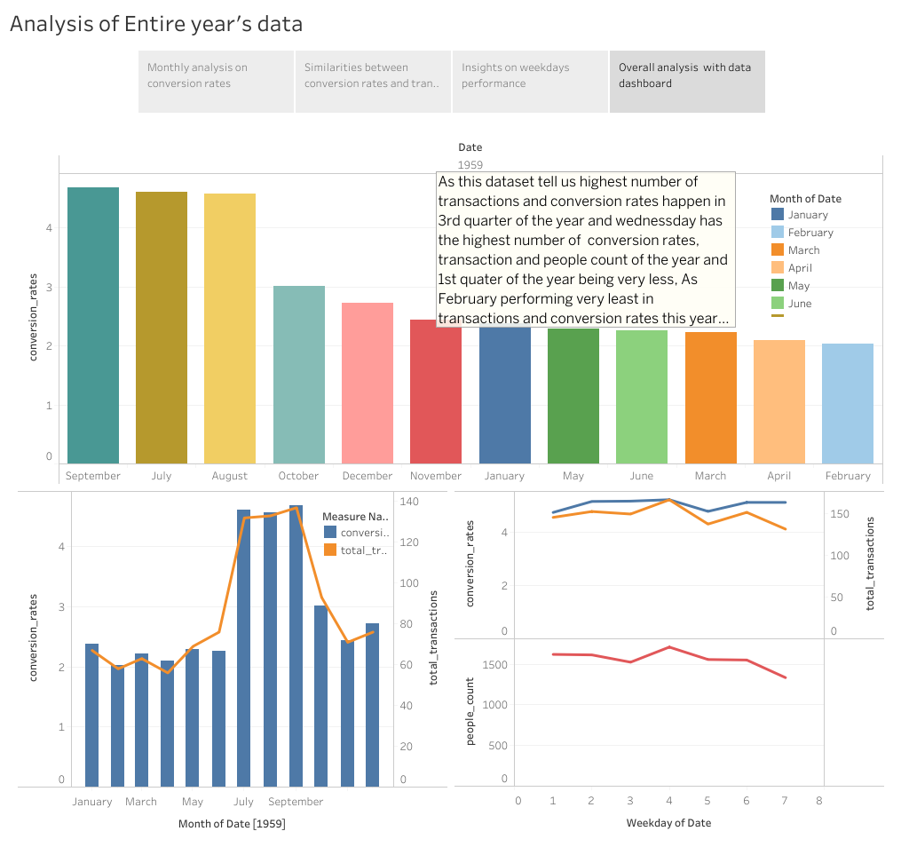

Slide 14
conclusion
A cost effective people counting system which not only counts the number of people but also generates and inputs data in a database with ease. And this is a perfect replacement for all the costly complex sensor technologies and usage of cloud services such as [AWS, Azure, IBM Watson, Google Cloud Platform] for AI inference.
As you saw above, that’s the basic kind of visualization which provides insights about a particular store. But this is just the tip of the iceberg, We can go way beyond by joining other databases like the products purchased for each transaction for more clear cut insights on what products were being sold mostly.
And If you are having multiple stores in different locations, This systems helps in bringing all the databases to one particular place for insights on how well each store is performing, and concentrate on improving the stores which aren’t performing well when compared to others.
This will help in investing on right products for better sales and most importantly customer feedback which helps in improving store’s performance time to time.

Slide 15
Thank you

